Slide 1
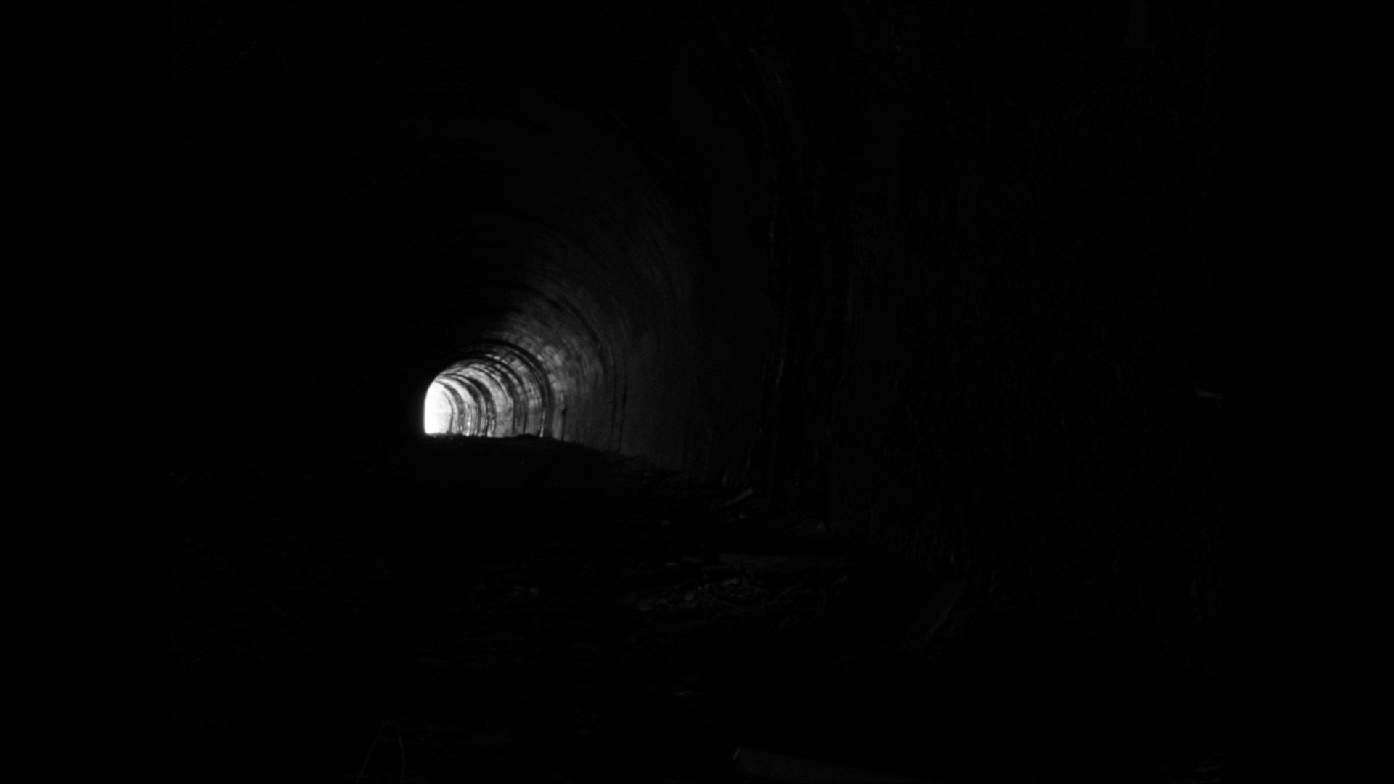

Slide 2
The wrath of God is being revealed...
...because humanity have turned their back on God.
Godlessness / Idolatry
A Downwards Spiral
Unrighteousness / Immorality / Depravity
The wrath of God – handed over to all manner of unrighteousness
homosexuality
a debased mind
Evil
covetousness
depravity
envy
murder
strife
deceit
maliciousness
gossips
slanderers
haters of God
insolent
haughty
boastful
inventors of evil
disobedient to parents
foolishheartless
ruthless
“The day of wrath” is coming – The Lord will require a reckoning

Slide 3
Romans 2:17 - 3:20

Slide 4
¹⁷ But if you call yourself a Jew and rely on the law and boast in God ¹⁸ and know his will and approve what is excellent, because you are instructed from the law; ¹⁹ and if you are sure that you yourself are a guide to the blind, a light to those who are in darkness, ²⁰ an instructor of the foolish, a teacher of children, having in the law the embodiment of knowledge and truth— ²¹ you then who teach others, do you not teach yourself? While you preach against stealing, do you steal?

Slide 5
²² You who say that one must not commit adultery, do you commit adultery? You who abhor idols, do you rob temples? ²³ You who boast in the law dishonor God by breaking the law. ²⁴ For, as it is written, “The name of God is blasphemed among the Gentiles because of you.”
²⁵ For circumcision indeed is of value if you obey the law, but if you break the law, your circumcision becomes uncircumcision.

Slide 6
²⁶ So, if a man who is uncircumcised keeps the precepts of the law, will not his uncircumcision be regarded as circumcision? ²⁷ Then he who is physically uncircumcised but keeps the law will condemn you who have the written code and circumcision but break the law. ²⁸ For no one is a Jew who is merely one outwardly, nor is circumcision outward and physical. ²⁹ But a Jew is one inwardly, and circumcision is a matter of the heart, by the Spirit, not by the letter. His praise is not from man but from God.

Slide 7
3 Then what advantage has the Jew? Or what is the value of circumcision? ² Much in every way. To begin with, the Jews were entrusted with the oracles of God. ³ What if some were unfaithful? Does their faithlessness nullify the faithfulness of God? ⁴ By no means! Let God be true though every one were a liar, as it is written,
“That you may be justified in your words,
and prevail when you are judged.”

Slide 8
⁵ But if our unrighteousness serves to show the righteousness of God, what shall we say? That God is unrighteous to inflict wrath on us? (I speak in a human way.) ⁶ By no means! For then how could God judge the world? ⁷ But if through my lie God’s truth abounds to his glory, why am I still being condemned as a sinner? ⁸ And why not do evil that good may come?—as some people slanderously charge us with saying. Their condemnation is just.

Slide 9
⁹ What then? Are we Jews any better off? No, not at all. For we have already charged that all, both Jews and Greeks, are under sin, ¹⁰ as it is written:
“None is righteous, no, not one;
¹¹ no one understands;
no one seeks for God.
¹² All have turned aside; together they have become worthless;
no one does good,
not even one.”

Slide 10
¹³ “Their throat is an open grave;
they use their tongues to deceive.”
“The venom of asps is under their lips.”
¹⁴ “Their mouth is full of curses and bitterness.”
¹⁵ “Their feet are swift to shed blood;
¹⁶ in their paths are ruin and misery,
¹⁷ and the way of peace they have not known.”
¹⁸ “There is no fear of God before their eyes.”

Slide 11
¹⁹ Now we know that whatever the law says it speaks to those who are under the law, so that every mouth may be stopped, and the whole world may be held accountable to God. ²⁰ For by works of the law no human being will be justified in his sight, since through the law comes knowledge of sin.

Slide 12
The Jews felt they were immune from judgment for 2 reasons:
They were God’s chosen people
They had God’s Law (which helped them to know right from wrong)0
But the Problem isn’t in the knowing – it’s in the doing
When God’s people do evil, it dishonours God
Empty religion :
does not exempt us from judgment
It’s not about what we show on the outside – it’s what’s happening in our heart
The Jews were entrusted with the oracles of God
The Law (Old Testament) “the embodiment of knowledge and truth”
God is always faithful to His covenant. He promised that when Israel rejected Him, He would punish them. (This is part of His covenant)
But they only wanted to claim the blessings
Christians can be in danger of becoming like the Jews. We claim the blessings, but shirk our responsibilities under the New Covenant

Slide 13
Why can’t I make myself righteous?
Why, on the “Day of Wrath”, will I be found “unrighteous”?
Because, without Jesus, we are under sin
Sin rules us
it reigns in our life
it controls us
To be saved, we need a new Lord
A new ruler
The Lord Jesus Christ

